Slide 1
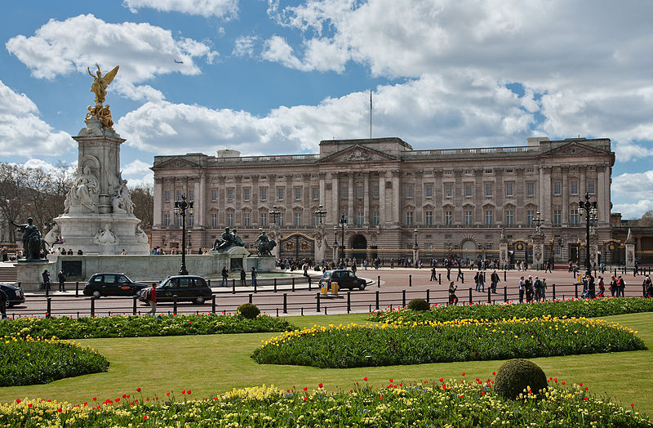
palace

Slide 2
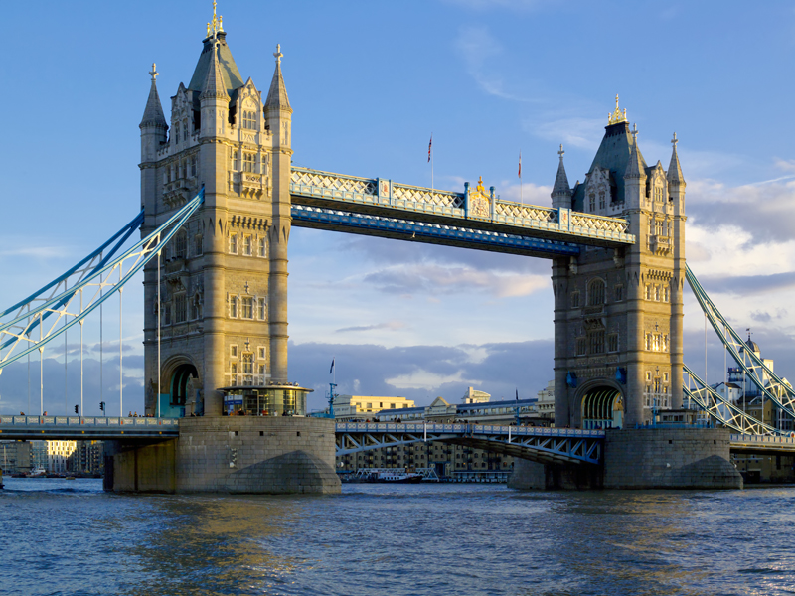
bridge

Slide 3
post office

Slide 4
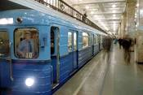
underground

Slide 5
railway station

Slide 6
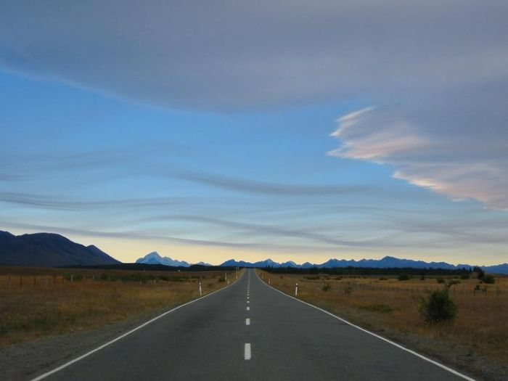
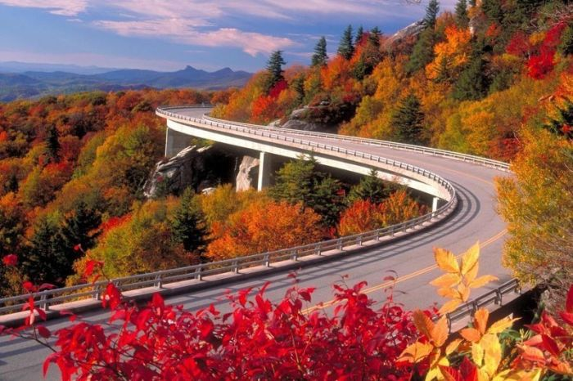
road straight far
turn

Slide 7
get to miss from

Slide 8
get to – добираться до miss - пропускать from – из, от, с

